Slide 1
MI-SMART
Medical Clearance Form
Michigan Psychiatric Care Improvement Project

Slide 2
OVERVIEW
Background
MI-SMART Form
Hack’s Impairment Index Score
Case Studies

Slide 3
Background

Slide 4
MI-SMART PURPOSE
Primary - To determine whether or not a medical illness is causing or exacerbating the psychiatric condition
Secondary - To identify medical or surgical conditions incidental to the psychiatric problem that may need treatment
Behavioral Health
Emergency Medicine
Behavioral Health
Emergency Medicine
Medical Clearance
Medical Clearance
Inpatient Psychiatry
Inpatient Psychiatry
Source: Zuhn, L. S. (n.d.). Continuum of Care for the Patient in Crisis From the ER to Community Zun. Retrieved from https://www.scribd.com/document/368238962/Continuum-of-Care-for-the-Patient-in-Crisis-From-the-ER-to-Community-Zun
Tucci, Veronica, et al. “Like the Eye of the Tiger: Inpatient Psychiatric Facility Exclusionary Criteria and Its ‘Knockout’ of the Emergency Psychiatric Patient.” Journal of Emergencies, Trauma, and Shock, vol. 10, no. 4, 2017, doi:10.4103/jets.jets_126_16.
Notes:
All three parts of the triangle must work in harmony in order for the patient’s needs to be best served.
The MI-SMART form is a tool which helps with harmony and communication.

Slide 5
MPCIP
  MDHHS and its community partners are in the process of implementing many crisis system improvements through the Michigan Psychiatric Care Improvement Project (MPCIP). Some examples are:
    Medical Clearance Algorithm
    Psychiatric Bed Registry
    Michigan Crisis and Access Line (MCAL)
    Psychiatric Residential Treatment Facilities
For more information please visit the MDHHS MPCIP website.
https://www.michigan.gov/documents/mdhhs/MIPAD_Workgroup_Report_-_Version_for_Publication_641418_7.pdf

Slide 6
MEDICAL CLEARANCE WORKGROUP
MDHHS partnered with Michigan Health and Hospital Association (MHA) to establish a workgroup of Emergency Medicine, Psychiatry, Psychology physicians, CMHSP representatives, and Crisis Service Providers.
For more information visit MDHHS MPCIP Website

Slide 7
OVERVIEW OF THE FRAMEWORK
While this is not a formal rule-making process; the intent is to offer similar public notice and opportunity for comment.
MI-SMART is an effective, standardized tool for determining medical stability for patients with a psychiatric crisis in emergency contexts. Benefits can include improved patient care and more efficient care coordination.
Notes:
Developers of the MI-SMART form and protocol took into consideration the work of two other pilots: Southeast Michigan Medical Clearance Pilot and Southwest Michigan SMART Form Pilot.
The current form is based on best practices from around state and country and feedback from a diverse group and a number of people.

Slide 8
QUALITY ASSURANCE PROCESS
Quality Improvement Feedback System
  Technical Issue(s) Feedback Loop
  Implementation Experience Survey
  Recommended Form changes are being gathered via the contact page.
  Additionally, feedback is being gathered via our email MPCIP-Support@MPHI.org

Slide 9
MI-SMART Form
Notes:
Michigan’s
SMART
Suspect New Onset of Psychiatric Condition
Medical Conditions that Require Screening
Abnormal Vital Signs, Mental Status, and Physical Examination
Risky Presentation
Therapeutic Levels Needed

Slide 10
FORM INSTRUCTIONS
The clinician should enter the patient’s demographic information and complete the Part 1 screen. Patients with negative findings (“No” selected for each item in Part 1) are considered medically stable and do not require further medical workup prior to inpatient psychiatric admission: the clinician should proceed to Part 4 and complete the attestation. Any positive finding (“Yes” selected in Part 1) may warrant further diagnostic studies (Part 2), and the clinician should proceed to Part 2. Any positive findings from Part 1 or Part 2 require a clinician explanation (Part 3) regarding the abnormal finding, the clinical significance, and the disposition plan before completing the attestation in Part 4.

Slide 11
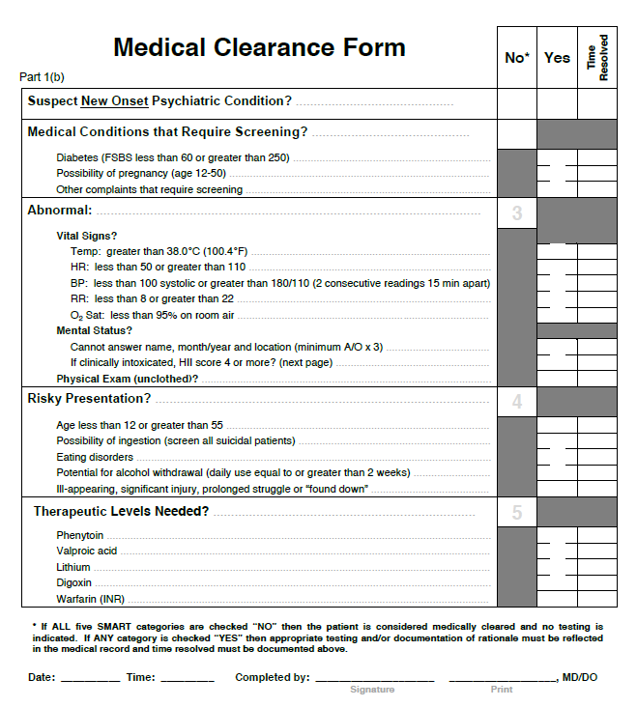
Part 1: SMART Medical Clearance Form
Notes:
Complete Part 1 following a comprehensive medical history, a thorough physical examination, and completion of the H-Impairment Index (HII) for clinical intoxication (see below).

Slide 12
SMART Form

Slide 13
SMART Form

Slide 14
SMART Form

Slide 15
SMART Form

Slide 16
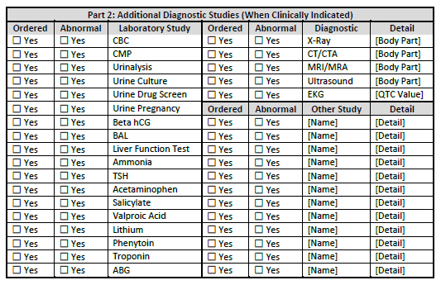
Part 2 – Additional Diagnostic Studies (When Clinically Indicated)
*Abnormal = Clinically Significant
Notes:
There was a recommendation that we change language from “Abnormal” to clinically significant. I think it will be too awkward to simply cut and paste. How about we place an * beside abnormal and then right below the chart place ”*Abnormal = Clinically Significant”?

Slide 17
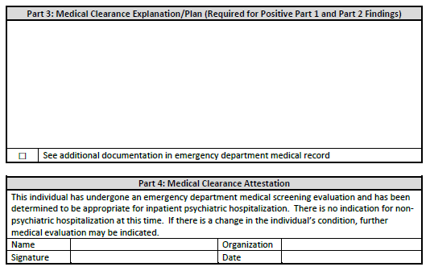
Part 3: Medical Clearance Explanation/Plan Required for Positive Part 1 and Part 2 Finding

Slide 18
Part 4: Medical Clearance Attestation

Slide 19
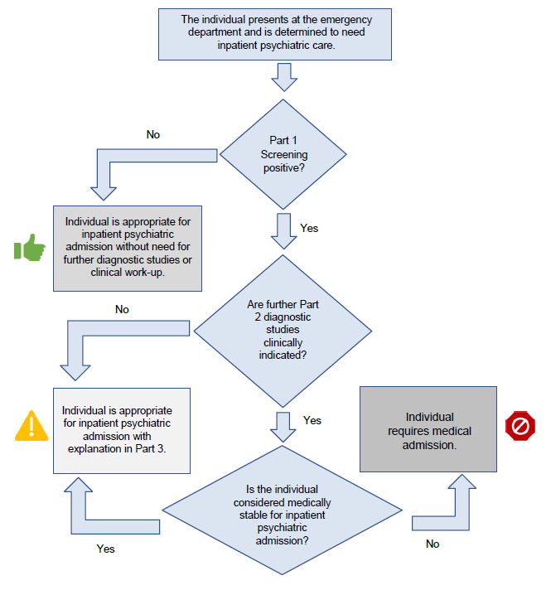
MI-SMART Flow

Slide 20
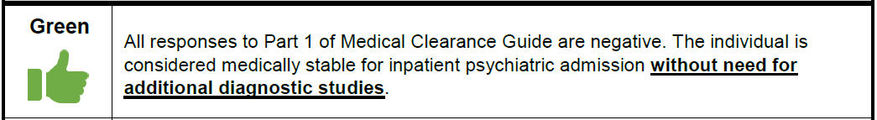
Green Thumbs Up Status
Notes:
GREEN (medically appropriate for psychiatric admission without need for further diagnostic testing);

Slide 21
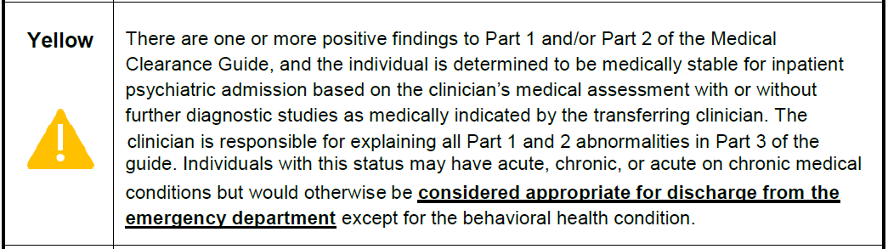
Yellow Caution Sign Status
Notes:
YELLOW (medically appropriate for psychiatric admission after further diagnostic testing and/or clinical explanation of medical condition);

Slide 22
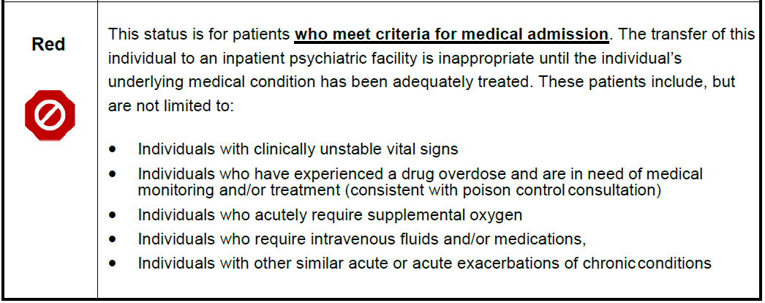
Red Stop Sign Status
Notes:
RED (admission to a psychiatric unit contraindicated until medical conditions are resolved)

Slide 23
Hack's Impairment Index (HII) Score
Source: Hack, J. B., Goldlust, E. J., Ferrante, D., & Zink, B. J. (2017). Performance of the Hacks Impairment Index Score: A Novel Tool to Assess Impairment from Alcohol in Emergency Department Patients. Academic Emergency Medicine, 24(10), 1193–1203. doi: 10.1111/acem.13266

Slide 24
CARE OF INTOXICATED ED PATIENTS
Intoxication confounds clinical evaluation
  Impairs the patient’s ability to identify and localize pain
  Makes it difficult to determine if mental status changes are due to intoxication, traumatic brain injury, or a mental health condition
Blood Alcohol Concentration (BAC)
  Correlates poorly with the level of intoxication
  Different levels of intoxication can be reported with the same BAC
HII is a quantitative tool to measure intoxication reliably and sensitively.
Notes:
Haydel MJ, Preston CA, Mills TJ, Luber S, Blaudeau E, DeBlieux PM. Indications for
computed tomography in patients with minor head injury. N Engl J Med 2000;
343(2):100–5.
Hoffman JR,Wolfson AB, Todd K, MowerWR. Selective cervical spine radiography in
blunt trauma: methodology of the national emergency X-radiography utilization
study (NEXUS). Ann Emerg Med 1998;32(4):461–9.
Rundhaug NP, Moen KG, Skandsen T, et al. Moderate and severe traumatic brain in
jury: Effect of blood alcohol concentration on Glasgow Coma Scale score and relation
to computed tomography findings. J Neurosurg 2015;122(1):211–8.
Shahin H, Gopinath SP, Robertson CS. Influence of alcohol on early Glasgow Coma
Scale in head-injured patients. J Trauma 2010;69(5):1176–81

Slide 25
H-Impairment Index (HII Score)
Scored 0-4 (Normal to Abnormal)
  Repeated until Total Score <4
Components
  Gross Motor Function
  Mentation and Speech
  Tracing Curve
  Nystagmus
  Finger to Nose Testing

Slide 26
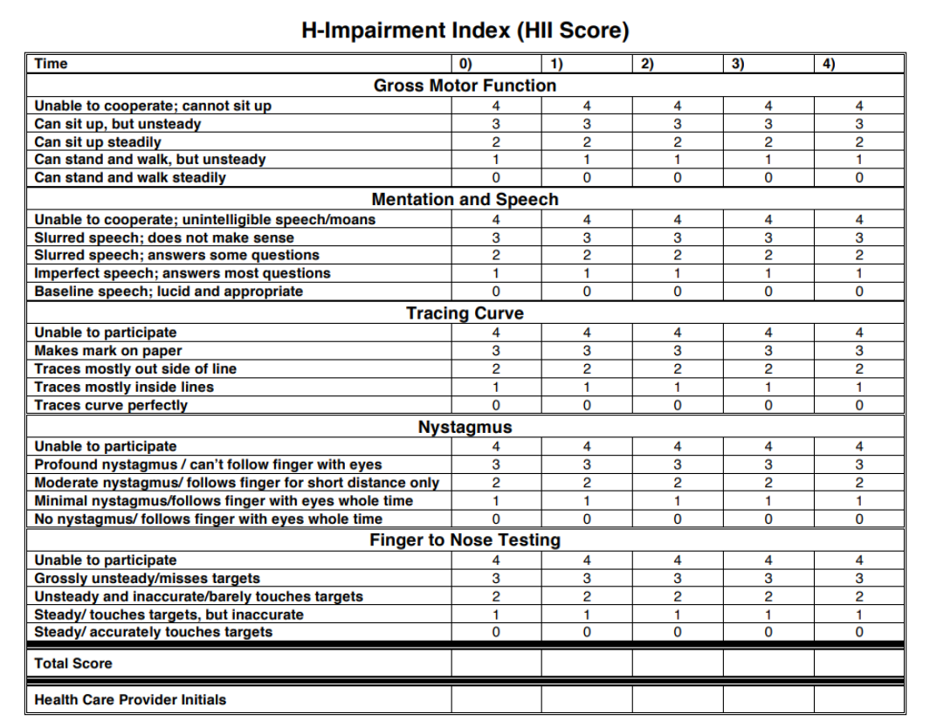
Notes:
HII is a tool used to formally assess clinical intoxication by allowing an objective assessment of the functional capacity of a patient in the setting of acute alcohol use. This should be completed on all patients that are clinically intoxicated (and/or who provide history of recent alcohol or drug use) and should be repeated as needed until the HII score is less than 4.
Blood/breath alcohol testing can be performed in conjunction with HII. However, it is not required for medical clearance unless otherwise clinically indicated.

Slide 27
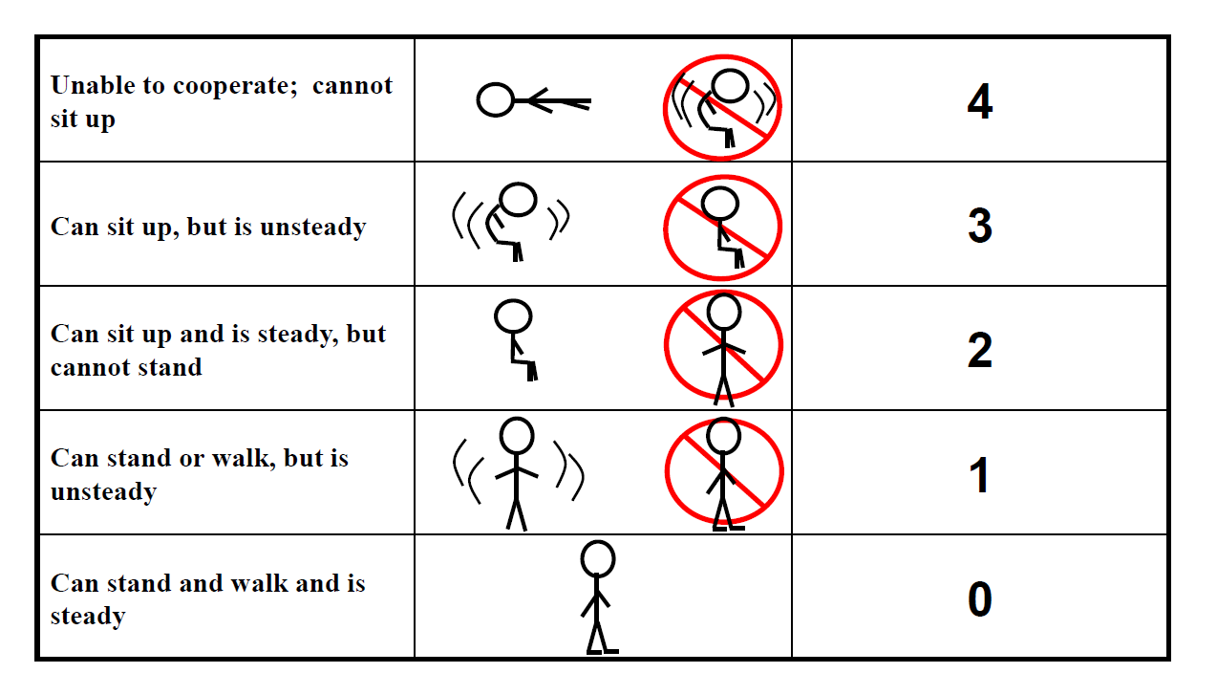
Gross Motor Function

Slide 28
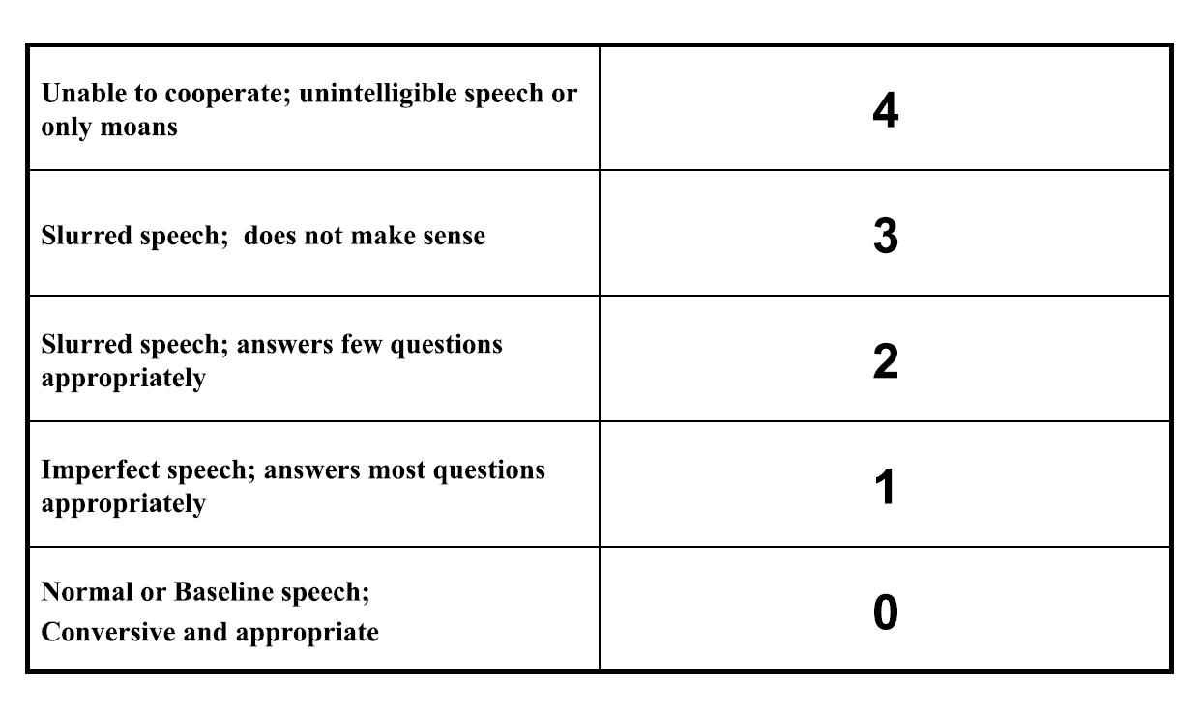
Mentation and Speech

Slide 29
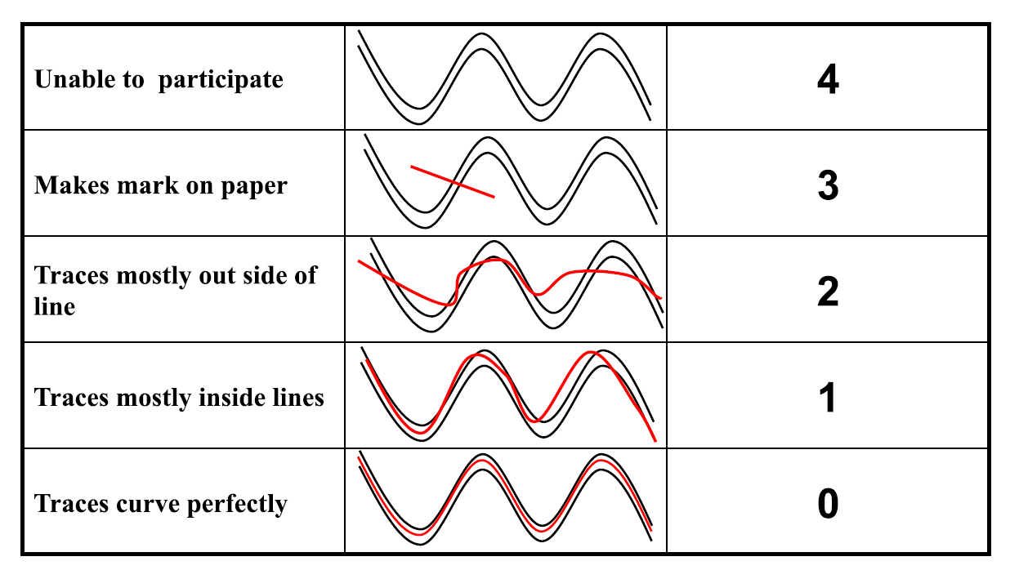
Tracing Curve

Slide 30
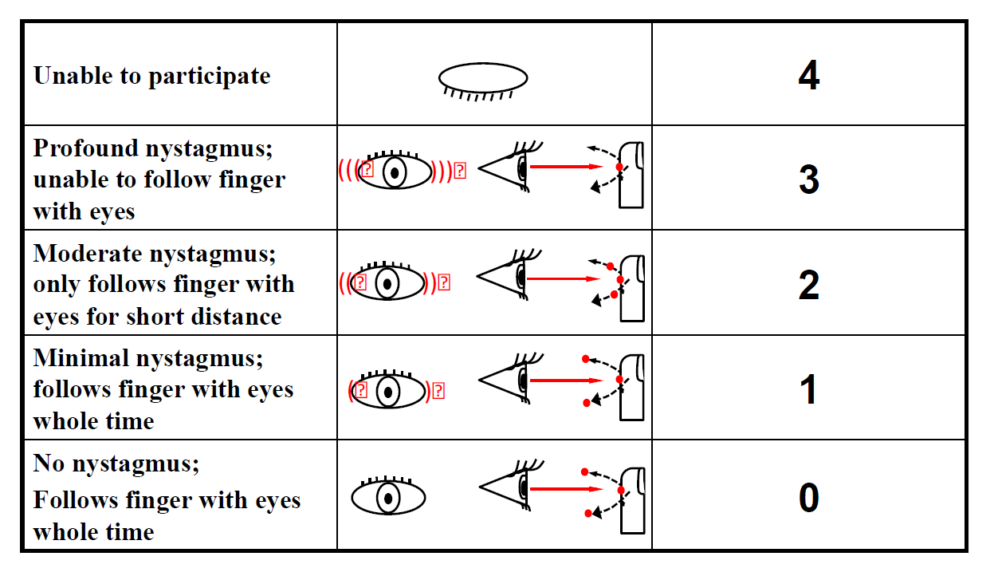
Nystagmus

Slide 31
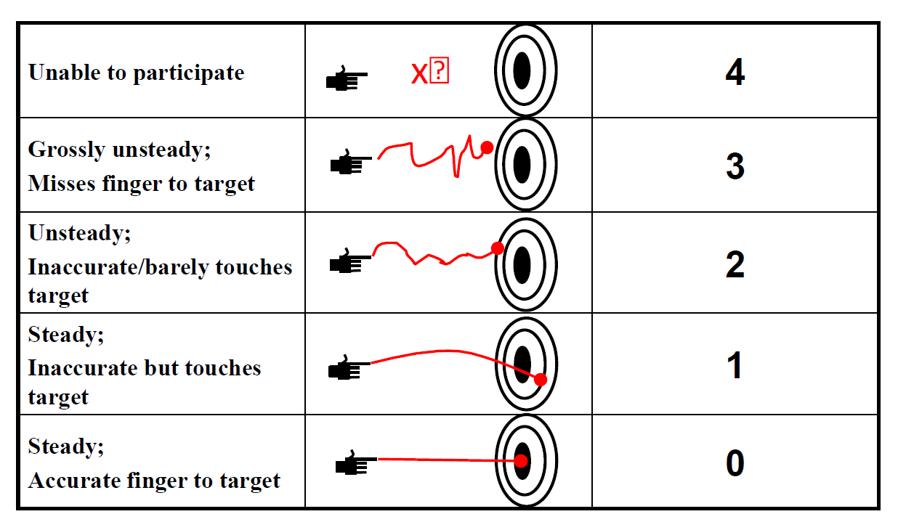
Finger to Nose Testing

Slide 32
HII EVIDENCE
Compared to other intoxication measurements, HII performed best.
  The Standardized Field Sobriety Test had a reduced utility to quantify intoxication at higher levels and may be difficult for patients to perform even when sober.
  The Binary Intoxication Question’s results showed that there were problems in determining who was sober before the alcohol challenge began.
  The St. Elizabeth Alcohol Intoxication Scale demonstrated little sensitivity for low or moderate levels of intoxication.
Advantages of HII
  Can be administered rapidly
  Requires no additional technology
  Source: Benoit, Justin L., et al. “Developing a Standardized Measurement of Alcohol Intoxication.” The American Journal of Emergency Medicine, vol. 35, no. 5, 2017, pp. 725–730., doi:10.1016/j.ajem.2017.01.009.
Notes:
Benoit, Justin L., et al. “Developing a Standardized Measurement of Alcohol Intoxication.” The American Journal of Emergency Medicine, vol. 35, no. 5, 2017, pp. 725–730., doi:10.1016/j.ajem.2017.01.009.
At this time, there is no peer-reviewed published evidence supporting the use of HII for substances other than alcohol. However, there are no other assessment tools that perform a clinical sobriety assessment for non-alcohol substances.

Slide 33
Case Studies

Slide 34
Case Illustration #1
A 23 year-old male presents to the emergency department by EMS with a past psychiatric history of schizophrenia. He has reportedly been off medications for several weeks and is showing signs of psychosis. The patient is in need of inpatient psychiatric care, and emergency department staff are pursuing outside placement.
Part 1: The Medical Stability Screen finds the following:
  He offers no medical complaints.
  He has no significant past medical history.
  He has no history or signs of impairment from substance use.
  His vital signs are normal as is the physical exam.
  All items in Part 1 Medical Stability Screen are answered ”No”.
What additional work-up and/or documentation is needed?
What is the Medical Clearance Status of this patient?

Slide 35

Case Illustration #1 (CONTINUED)
Because all items in Part 1 are negative, no additional diagnostic studies or further documentation are required for this patient.
The patient’s Medical Clearance Status is Green Thumbs Up
The patient is considered medically stable and should be accepted by an appropriate facility without the need for any diagnostic studies.
A copy of the emergency physician’s report including history, physical examination, and medical decision-making should accompany the patient during the transfer.

Slide 36
Case Illustration #2
A 48 year-old female presents to the emergency department with depression and suicidal ideations. The patient has no past psychiatric history. The patient is in need of inpatient psychiatric care and staff are pursuing outside placement.
Part 1: The Medical Stability Screen finds the following:
  She offers no medical complaints
  Her past medical history is remarkable for high blood pressure, and she is reportedly compliant with medications.
  She has no history of or signs of impairment from substance use.
  Here vital signs are normal as well as the physical exam.
  Except for this being a new psychiatric condition, all other items in Part 1 Medical Stability Screen are answered ”No”
What additional work-up and/or documentation is needed?
What is the Medical Clearance Status of the patient?

Slide 37

Case Illustration #2 (CONTINUED)
Because this is a new psychiatric condition, a more extensive medical workup is indicated.
The emergency physician orders the following which are all normal/negative.
  CBC, comprehensive metabolic panel, UA, urine pregnancy, urine drug screen, thyroid study (TSH), ETOH, acetaminophen, and salicylates
Since a detailed neurologic exam is normal, no imaging is performed
The patient’s Medical Clearance Status is Yellow Caution Sign
The emergency physician documents in Part 3: “This patient presents with her first known episode of depression. This is the only Part 1 positive finding. Laboratory studies were done as noted in Part 2 and were normal/negative. No imaging was indicated. Her past medical history is remarkable for controlled hypertension. She should be continued on her home BP meds. She is considered medically stable for transfer for inpatient psychiatric care.”

Slide 38
CASE ILLUSTRATION #3
A 28-year-old male presents to the ED with acute exacerbation of bipolar disease. The patient has an established history and has stopped all medications. The patient is in need of inpatient psychiatric care and staff are pursuing outside placement.=
Part 1: The Medical Stability Screen finds the following:
  History of asthma and recent wheezing and labored breathing
  Past medical history is remarkable only for asthma
  No history or signs of impairment from substance use
  Vital signs are normal but wheezes are heard in all fields
  Except for co-occurring asthma, all other items in the Part 1 Medical Stability Screen are answered, “No.”
What additional work-up and/or documentation is needed?
What is the Medical Clearance Status for this patient?

Slide 39
CASE ILLUSTRATION #3 (CONT.)
The emergency physician orders 2 breathing treatments and oral prednisone, and the patient fully clears.
  No further medical diagnostic studies or treatments are indicated.
Because of the co-occurring asthma attack, the patient’s Medical Clearance Status is Yellow Caution Sign
The emergency physician documents in Part 3:
  “This patient presents with an exacerbation of bipolar disorder and a co-occurring asthma attack which is the only Part 1 positive finding. The asthma fully improved after 2 nebulizer treatments and prednisone. Medically he is appropriate for discharge with a 5-day course of prednisone (60 mg daily) and albuterol inhaler use (2 puffs every 4 hours, as needed). He is considered medically stable for transfer to inpatient psychiatric care.”

Slide 40
CASE ILLUSTRATION #4
A 53-year-old female presents to the ED due to progressive confusion over the past 3 days. This is a new problem. The ED physician initially believes the patient will need inpatient psychiatric care.
Part 1: The Medical Stability Screen finds the following:
  This is a new psychiatric condition.
  No significant past medical history or medications
  No history or signs of impairment from substance use
  Vital signs are normal except for a heart rate in the 120s
  Physical exam is remarkable for confusion and anxiety
  Otherwise, questions in the Part 1 Medical Stability Screen are answered, “No.”
What additional work-up and/or documentation is needed?
What is the Medical Clearance Status of this patient?

Slide 41

CASE ILLUSTRATION #4 (CONT.)
Because this is a new psychiatric condition, a more extensive medical workup is indicated.
The emergency physician orders the following, which are all normal/ negative, except for the TSH, which is not available as it must be sent out.
  CBC, comprehensive metabolic panel, UA, urine drug screen, thyroid study (TSH), ETOH, and head CT
The increased heart rate persists after lorazepam is administered for anxiety and a liter of normal saline IV is administered for possible dehydration.
Because of the persistent increased heart rate, the Medical Clearance Status is Red Stop Sign
It is NOT appropriate to send the patient to a psychiatric unit. The patient is ultimately diagnosed with thyrotoxicosis (thyroid disease), which caused the confusion, and this fully resolves with medical treatment.

Slide 42
RESOURCES AND SUPPORT
Visit the MDHHS MPCIP website for more resources and to learn more about the Michigan Psychiatric Care Improvement Project.
Contact the MPCIP team with questions at MPCIP-support@mphi.org.

